Slide 1
Data Warehouse
Dibya Tara Shakya

Slide 2

Inmon
Father of the data warehouse
Co-creator of the Corporate
Information Factory.
He has 35 years of
experience in database
technology management
and data warehouse design.

Slide 3
Inmon-Cont’d
Bill has written about a variety
of topics on the building, usage,
& maintenance of the data warehouse
& the Corporate Information Factory.
He has written more than 650
articles (Datamation, ComputerWorld,
and Byte Magazine).
Inmon has published 45 books.
Many of books has been translated to Chinese, Dutch, French, German, Japanese, Korean, Portuguese, Russian, and Spanish.

Slide 4
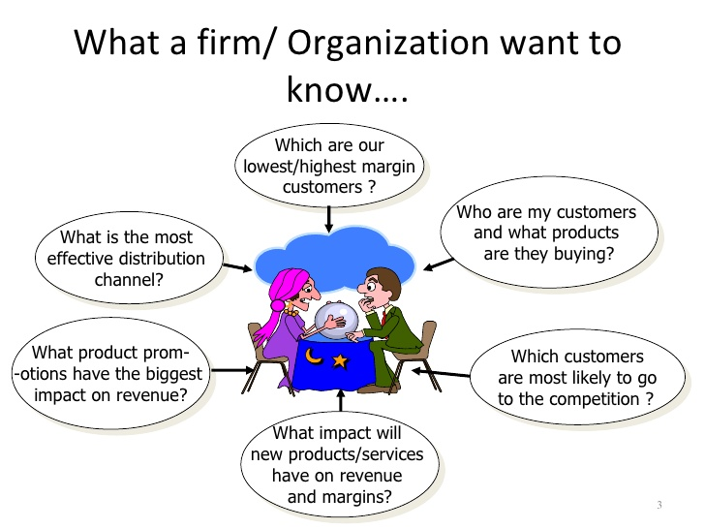

Slide 5
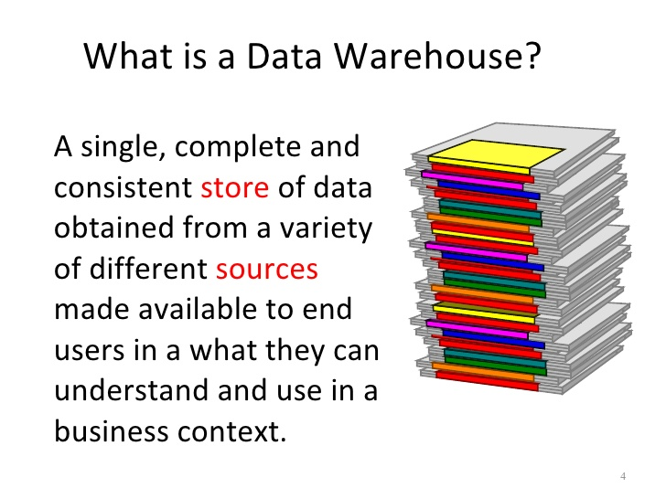

Slide 6
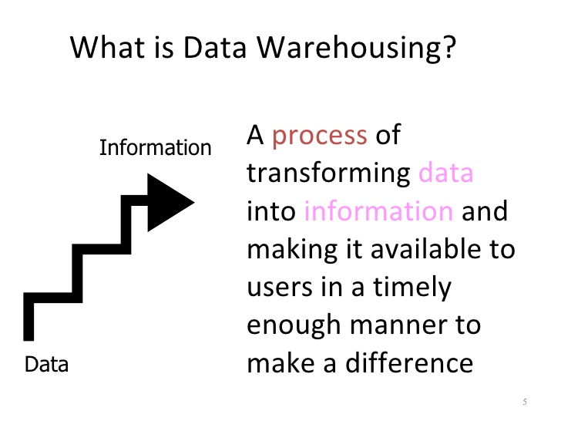

Slide 7
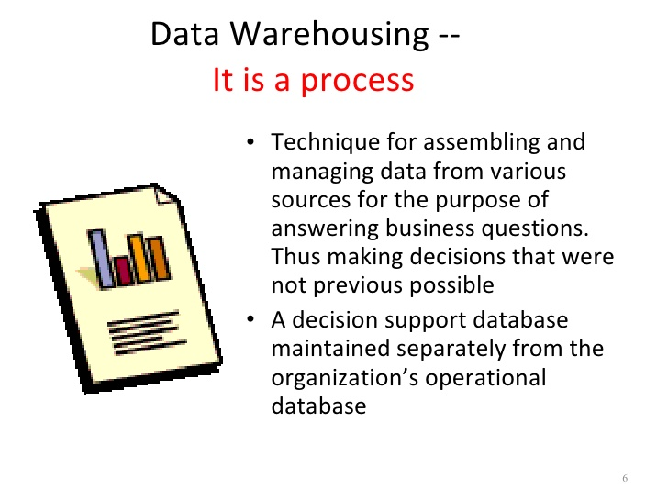

Slide 8
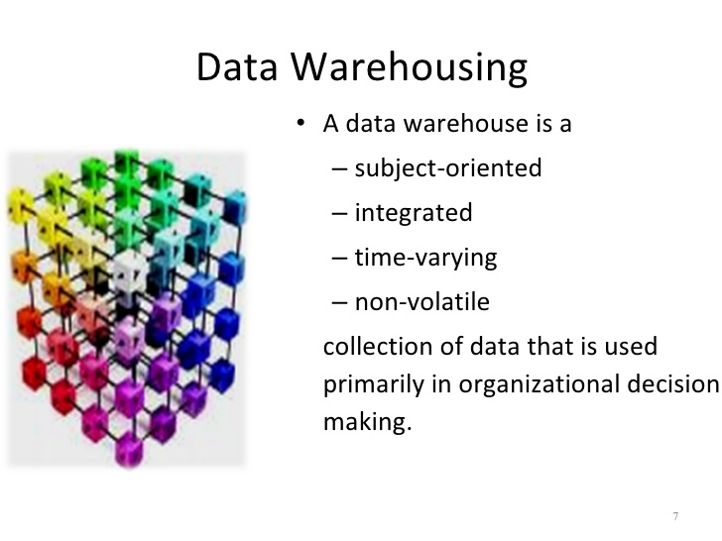

Slide 9
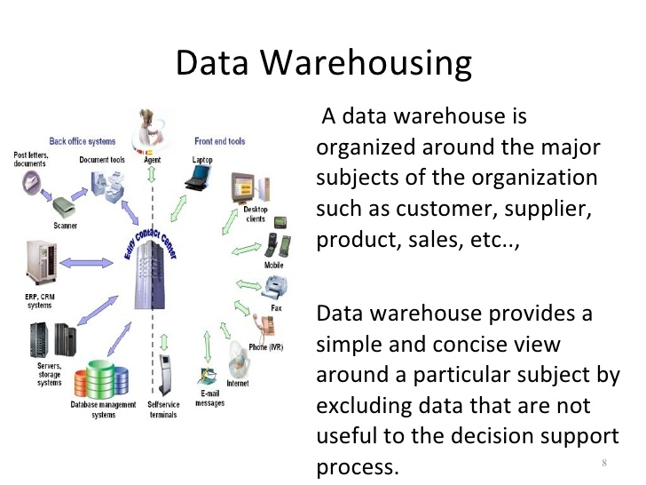

Slide 10
Introduction
What is Data Warehouse?
A data warehouse is a collection of integrated databases designed to support a DSS.
According to Inmon’s (father of data warehousing) definition(Inmon,1992a,p.5):
It is a collection of integrated, subject-oriented databases designed to support the DSS function, where each unit of data is non-volatile and relevant to some moment in time.

Slide 11
Introduction-Cont’d.
Where is it used?
It is used for evaluating future strategy.
It needs a successful technician:
Flexible.
Team player.
Good balance of business and technical understanding.

Slide 12
Introduction-Cont’d.
The ultimate use of data warehouse is Mass Customization.
For example, it increased Capital One’s customers from 1 million to approximately 9 millions in 8 years.
Just like a muscle: DW increases in strength with active use.
With each new test and product, valuable information is added to the DW, allowing the analyst to learn from the success and failure of the past.
The key to survival:
Is the ability to analyze, plan, and react to changing business conditions in a much more rapid fashion.

Slide 13
Data Warehouse
In order for data to be effective, DW must be:
Consistent.
Well integrated.
Well defined.
Time stamped.
DW environment:
The data store, data mart & the metadata.

Slide 14
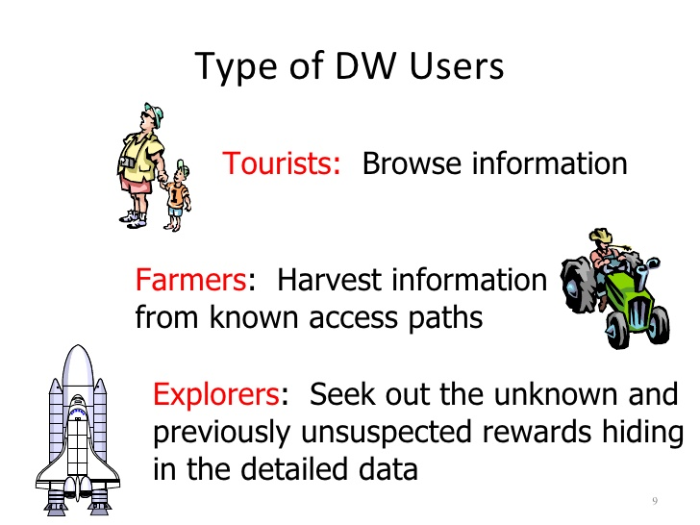

Slide 15
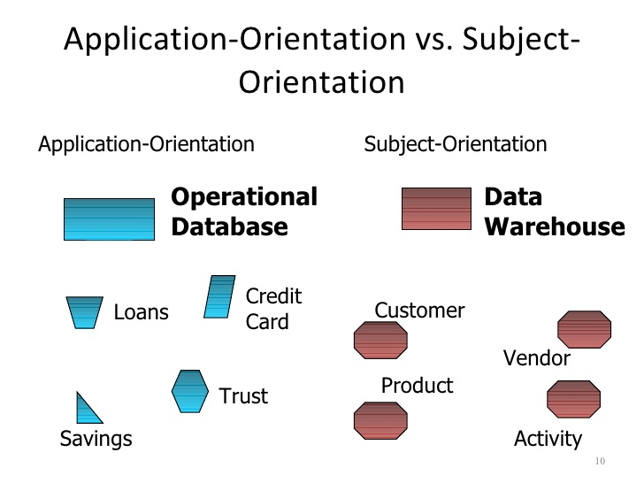

Slide 16
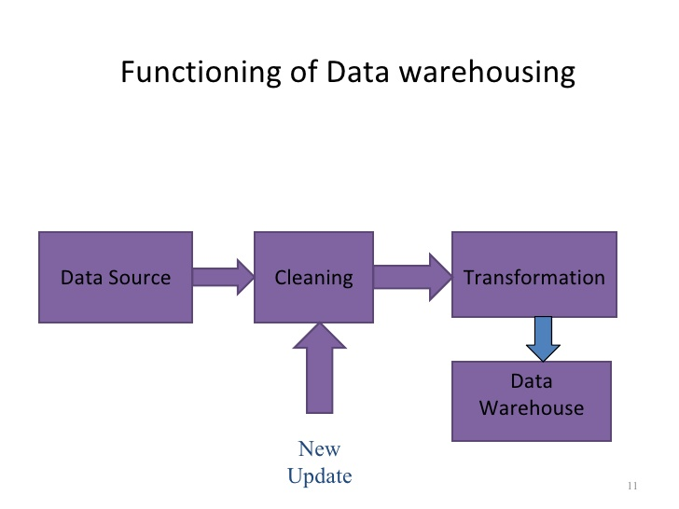

Slide 17
The Data Store
An operational data store (ODS) stores data for a specific application. It feeds the data warehouse a stream of desired raw data.
Is the most common component of DW environment.
Data store is generally subject oriented, volatile, current commonly focused on customers, products, orders, policies, claims, etc…

Slide 18
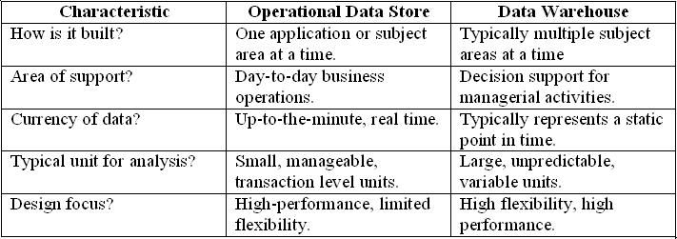
Data Store & Data Warehouse
Data store & Data warehouse

Slide 19
The data store-Cont’d.
Its day-to-day function is to store the data for a single specific set of operational application.
Its function is to feed the data warehouse data for the purpose of analysis.

Slide 20
The Data Mart
It is lower-cost, scaled down version of the DW.
Data Mart offer a targeted and less costly method of gaining the advantages associated with data warehousing and can be scaled up to a full DW environment over time.

Slide 21
The Meta Data
Last component of DW environments.
It is information that is kept about the warehouse rather than information kept within the warehouse.
Legacy systems generally don’t keep a record of characteristics of the data (such as what pieces of data exist and where they are located).
The metadata is simply data about data.

Slide 22
Components of the Metadata
Transformation maps – records that show what transformations were applied
Extraction & relationship history – records that show what data was analyzed
Algorithms for summarization – methods available for aggregating and summarizing
Data ownership – records that show origin
Patterns of access – records that show what data are accessed and how often

Slide 23
Typical Mapping Metadata
Transformation mapping records include:
Identification of original source
Attribute conversions
Physical characteristic conversions
Encoding/reference table conversions
Naming changes
Key changes
Values of default attributes
Logic to choose from multiple sources
Algorithmic changes

Slide 24
Conclusion
A Data Warehouse is a collection of integrated subject-oriented databases designed to support a DSS.
Each unit of data is non-volatile and relevant to some moment in time.
An operational data store (ODS) stores data for a specific application. It feeds the data warehouse a stream of desired raw data.
A data mart is a lower-cost, scaled-down version of a data warehouse, usually designed to support a small group of users (rather than the entire firm).
The metadata is information that is kept about the warehouse.

Slide 25
Characteristics of Data Warehouse
Subject oriented. Data are organized based on how the users refer to them.
Integrated. All inconsistencies regarding naming convention and value representations are removed.
Nonvolatile. Data are stored in read-only format and do not change over time.
Time variant. Data are not current but normally time series.

Slide 26
Characteristics of Data Warehouse
Summarized Operational data are mapped into a decision-usable format
Large volume. Time series data sets are normally quite large.
Not normalized. DW data can be, and often are, redundant.
Metadata. Data about data are stored.
Data sources. Data come from internal and external unintegrated operational systems.

Slide 27
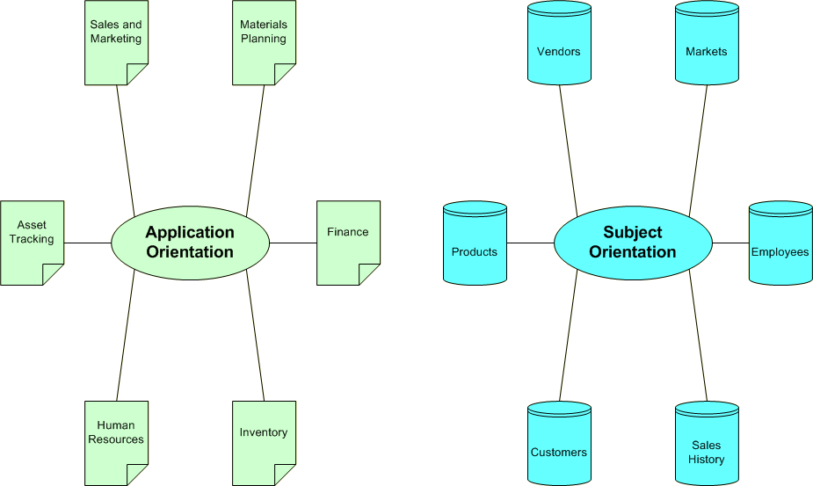
A Data Warehouse is Subject Oriented

Slide 28
Subject Orientation
Application Environment | Data warehouse Environment
Design activities must be equally focused on both process and database design | DW world is primarily void of process design and tends to focus exclusively on issues of data modeling and database design

Slide 29
Data Integrated
Integration –consistency naming conventions and measurement attributers, accuracy, and common aggregation.
Establishment of a common unit of measure for all synonymous data elements from dissimilar database.
The data must be stored in the DW in an integrated, globally acceptable manner

Slide 30
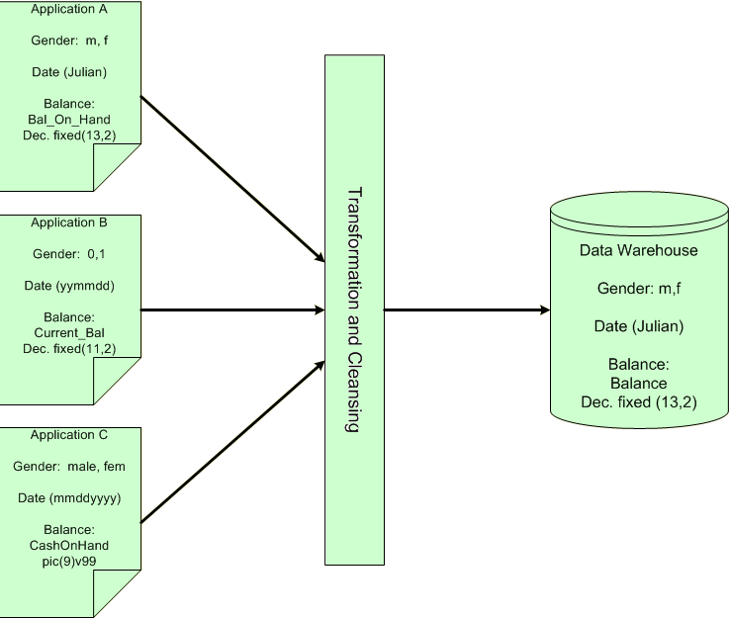
Data Integrated

Slide 31
Time Variant
In an operational application system, the expectation is that all data within the database are accurate as of the moment of access. In the DW data are simply assumed to be accurate as of some moment in time and not necessarily right now.
One of the places where DW data display time variance is in the structure of the record key. Every primary key contained within the DW must contain, either implicitly or explicitly an element of time( day, week, month, etc)

Slide 32
Time Variant
Every piece of data contained within the warehouse must be associated with a particular point in time if any useful analysis is to be conducted with it.
Another aspect of time variance in DW data is that, once recorded, data within the warehouse cannot be updated or changed.

Slide 33
Nonvolatility
Typical activities such as deletes, inserts, and changes that are performed in an operational application environment are completely nonexistent in a DW environment.
Only two data operations are ever performed in the DW: data loading and data access

Slide 34
Nonvolatility
Application | DW
The design issues must focus on data integrity and update anomalies. Complex processes must be coded to ensure that the data update processes allow for high integrity of the final product. | Such issues are no concern to in a DW environment because data update is never performed.
Data is placed in normalized form to ensure a minimal redundancy (totals that could be calculated would never be stored) | Designers find it useful to store many of such calculations or summarizations.
The technologies necessary to support issues of transaction and data recovery, roll back, and detection and remedy of deadlock are quite complex. | Relative simplicity in technology

Slide 35
The Data Warehouse Architecture
The architecture consists of various interconnected elements:
Operational and external database layer – the source data for the DW
Information access layer – the tools the end user access to extract and analyze the data
Data access layer – the interface between the operational and information access layers
Metadata layer – the data directory or repository of metadata information

Slide 36
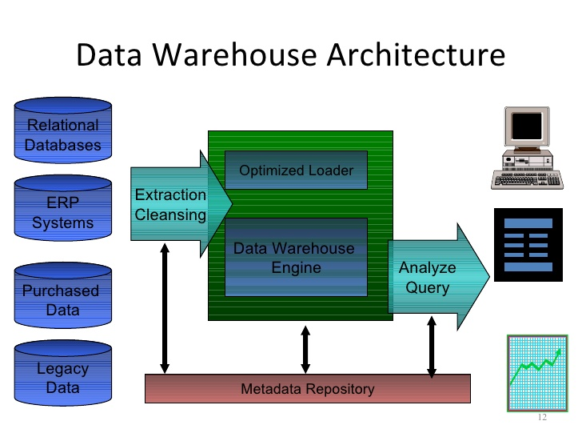

Slide 37
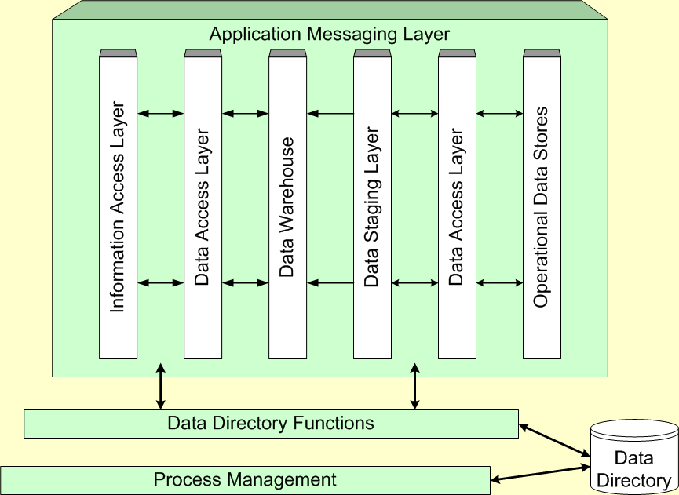
Components of the Data Warehouse Architecture

Slide 38
Data Warehousing Typology
The virtual data warehouse – the end users have direct access to the data stores, using tools enabled at the data access layer
The central data warehouse – a single physical database contains all of the data for a specific functional area
The distributed data warehouse – the components are distributed across several physical databases

Slide 39
Data Warehouse Technologies
No one currently offers an end-to-end DW solution. Organizations buy bits and pieces from a number of vendors and hopefully make them work together.
SAS, IBM, Software AG, Information Builders and Platinum offer solutions that are at least fairly comprehensive.
The market is very competitive. Table 10-6 in the text lists 90 firms that produce DW products.

Slide 40
The Future of Data Warehousing
As the DW becomes a standard part of an organization, there will be efforts to find new ways to use the data. This will likely bring with it several new challenges:
Regulatory constraints may limit the ability to combine sources of disparate data.
These disparate sources are likely to contain unstructured data, which is hard to store.
The Internet makes it possible to access data from virtually “anywhere”. Of course, this just increases the disparity.

Slide 41
Objective
Interesting Facts
Data Can be Used To
Robust Infrastructure
Success of Data Warehouse Projects
Implementing Data Warehouse
Real Time Alerts & Integration
Identity Theft
What Can You Do?

Slide 42
Interesting Facts
Harrah’s Entertainment’s Data Warehouse holds 30 terabytes, or 30 trillion bytes of data, roughly three times the number of printed characters in the Library of Congress
Casinos, retailers, airlines, and banks are piling up data so vast, it would have been unthinkable years ago; result from the curse of cheap storage

Slide 43
Interesting Facts
Storage Shipments as of 2004: 22 exabytes or 22 million trillion bytes of hard disk space, double the amount in 2002.
Equivalent to 4x’s the space needed to store every word ever spoken by every human being who has ever lived.
Should double again in 2006

Slide 44
Data Can be Used To
Quantify the volume impact of vehicles across the marketing matrix
Account for decay and saturation factors in the determination of investment choices and returns
Execute “what-if” simulations of pricing or promotional scenarios before a proposed action is taken
Provide a continuous planning, measurement, analysis and optimization cycle supported by a software structure
Deliver robust data feeds into other systems supporting supply chain, sales, and financial reporting and endeavors

Slide 45
Robust Infrastructure
Data Identification and Acquisition
Data Cleansing, Mapping, and Transformation
Production System Loading and Ongoing Update
Notes:
To maintain a robust infrastructure, you should follow these guidelines.
Which data sources reflect the dynamics of the contemporary and historical market place.
Validity Checks,
Above loaded into the integrated data repository enabling a continuous cycle of near-time data availability

Slide 46
Success of Data Warehouse Projects
Over half of Data Warehouse projects are Doomed
Fail due to lack of attention to Data Quality Issues
More than half only have limited acceptance
Consistency and Accuracy of Data
Most businesses fail to use business intelligence (BI) strategically
IT organizations build data warehouses with little to no business involvement

Slide 47
“A real-time enterprise without real-time business intelligence is a real fast, dumb organization.”
Stephen Brobst
Chief Technology Office
Teradata

Slide 48
Success of Data Warehouse Projects
Most challenging type of deployment for an enterprise
Large scale and complex system configurations
Sophisticated data modeling and analysis tools
High visibility in broad range of important business functions within company
Adoption of Linux-Based Platform

Slide 49
Implementing Data Warehouse
Challenges:
Identifying new processes
Assuring there were of real use
Implementing and ensuring cultural shifts
Managing content and New communities towards a common benefit
Linear models
Standards, Governance, Controls, Valuation
Notes:
These challenges are especially predominant in dot-com companies.
The key word of Implementing Data Warehouse is Convergence!
The inherent Linear relationship was either business has driven requirements for IT or IT has been an enabler of business. This was a practical need of separation.
Structural changes in business as a result of endemic information technology (information power on all desktops and many businesspersons acting as their own information centers, automated information is a basic lubricant of all business processes.)
Convergence means that info is no longer a separate commodity.
For the Final Note: Information, as any other business commodity, deserves the same treatment as any other core component of business

